Slide 1
SETS (I)
Content
. Introduction
. Representation of Sets
. Finite And Infinite Sets
. The Empty Set
. Equal & equivalent Sets
. Subsets
.Intervals as Subset
.Power Set

Slide 2
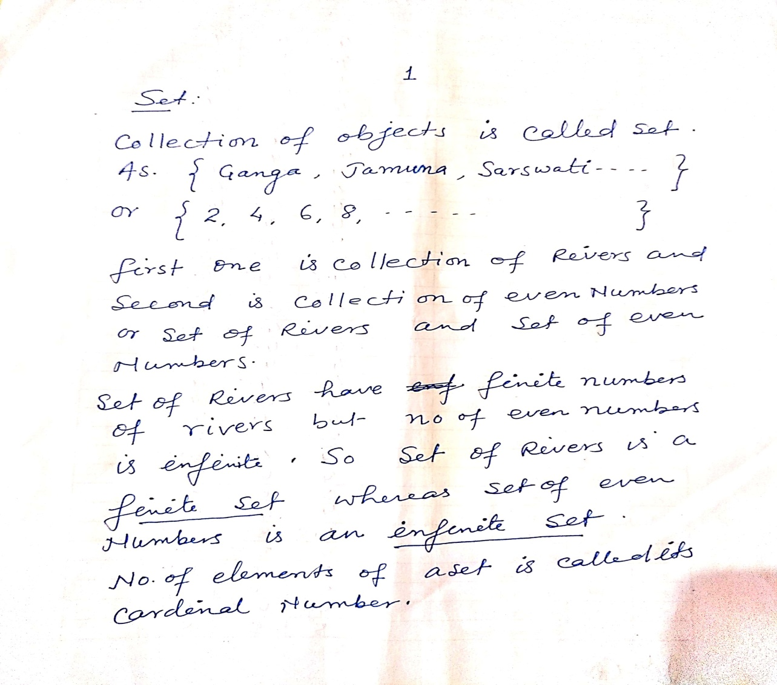
Introduction

Slide 3
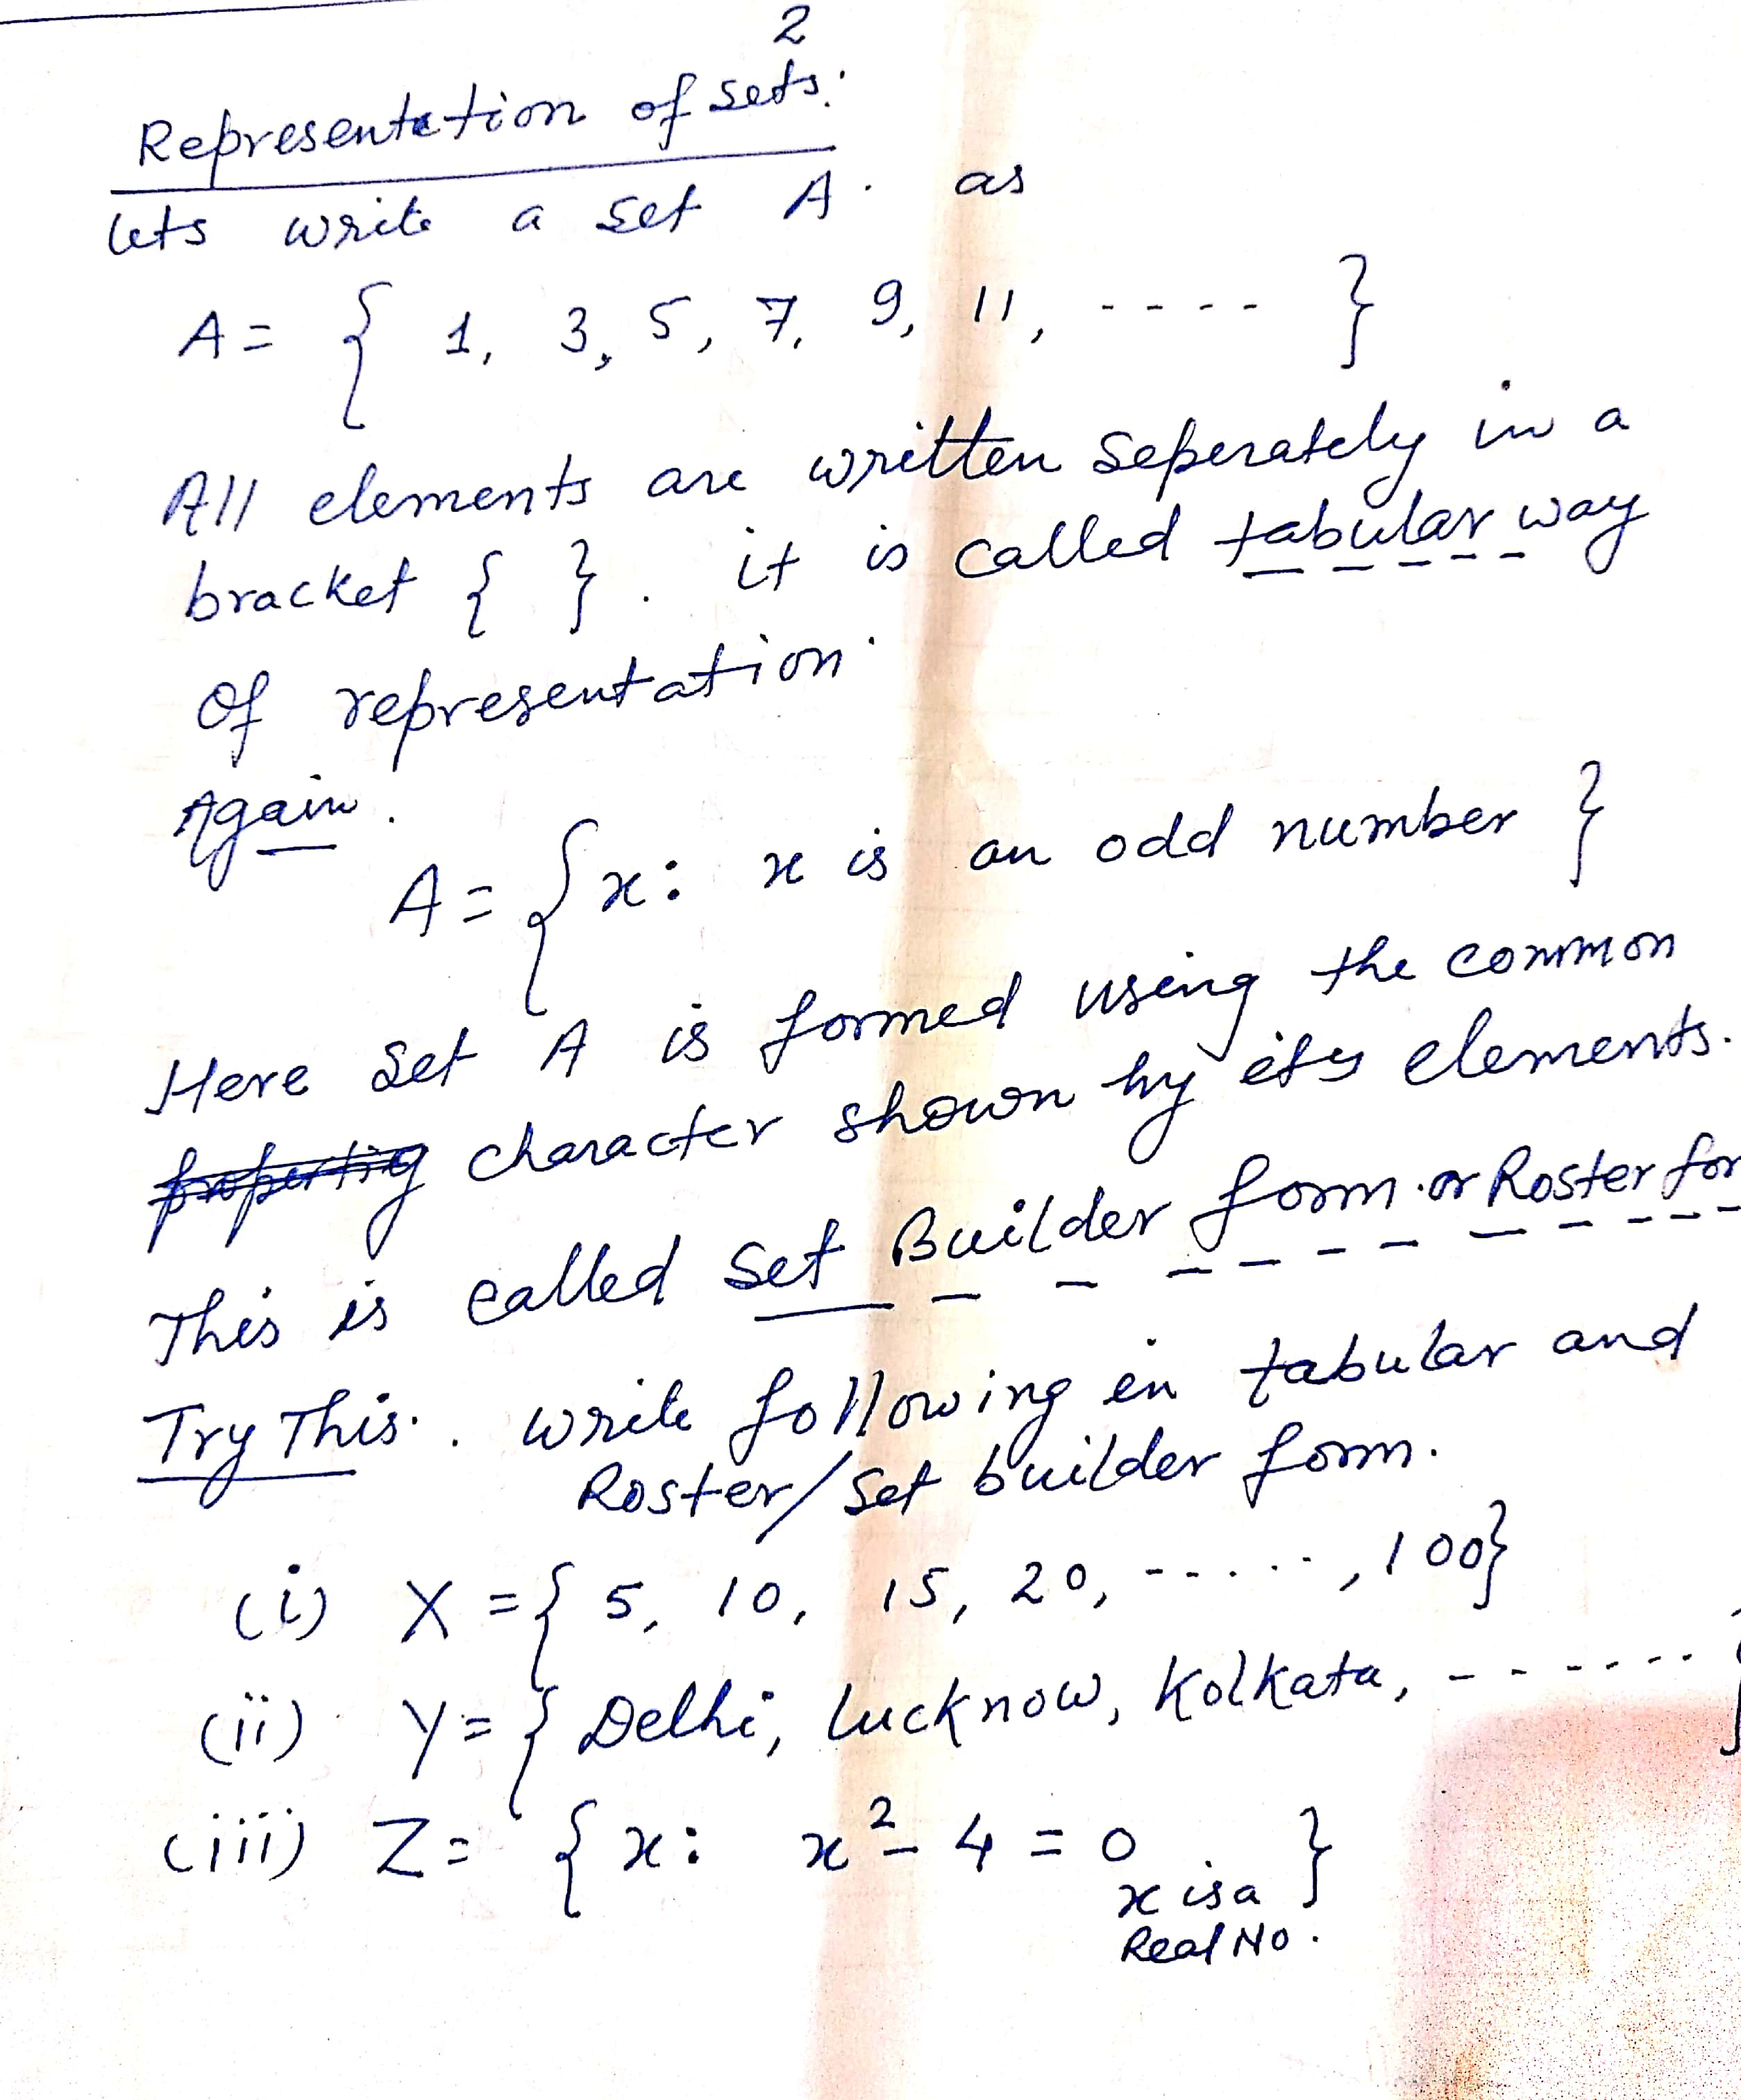
Representation of Sets

Slide 4
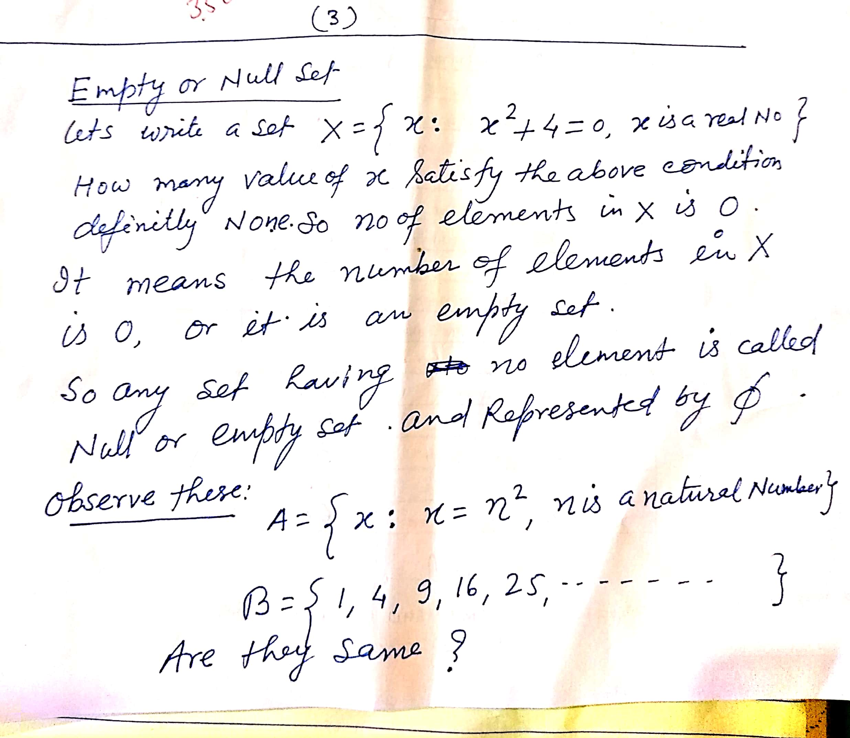
Empty Set

Slide 5
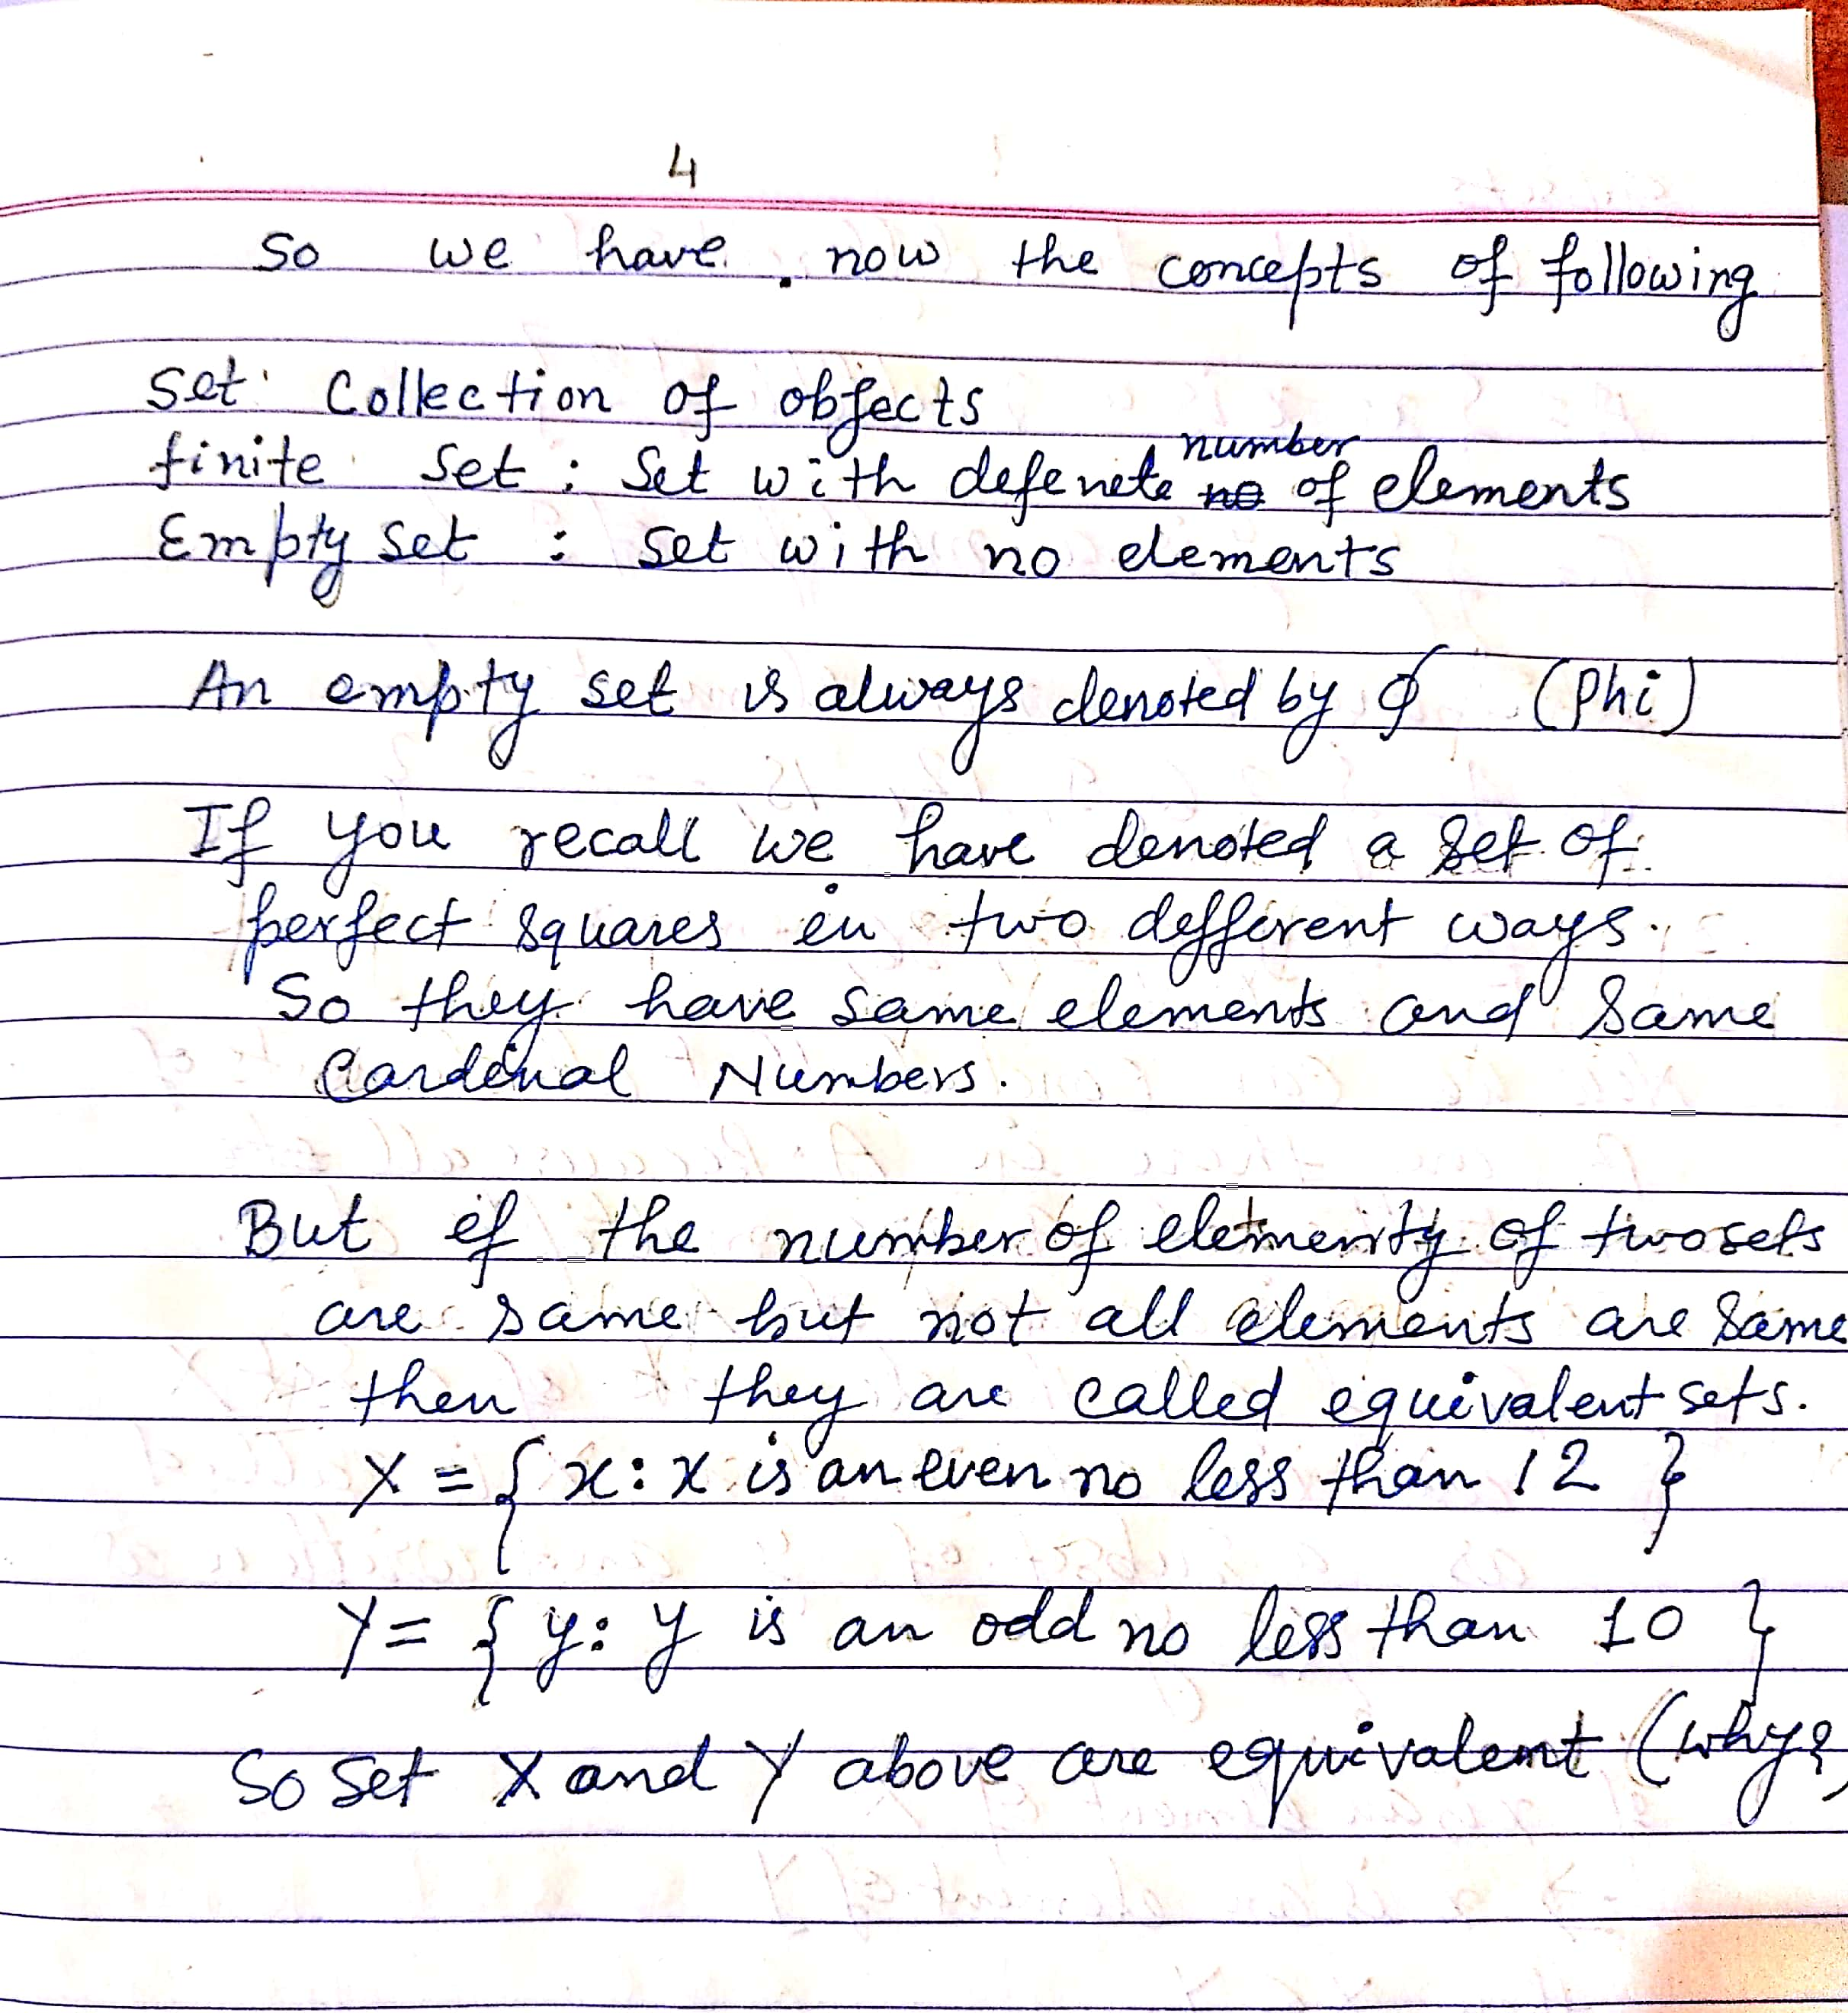
Equal & Equivalent Sets

Slide 6
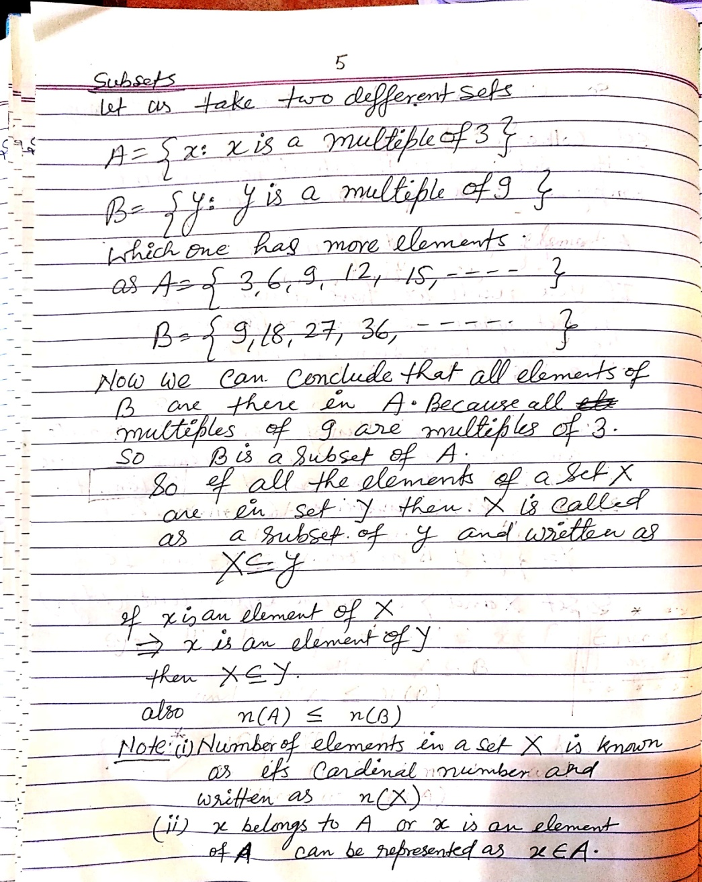
Subsets

Slide 7
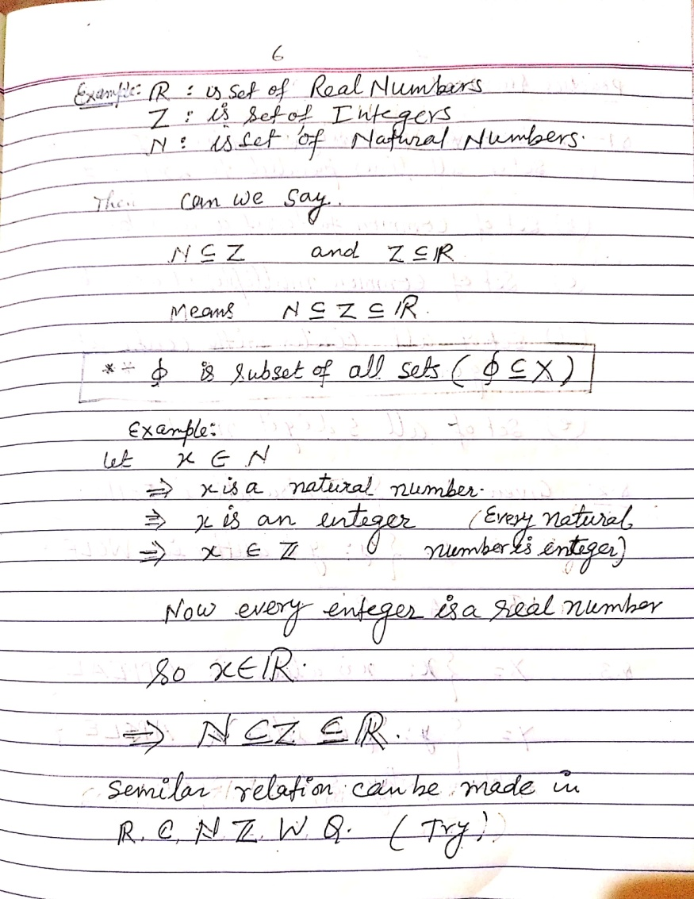
Subsets

Slide 8
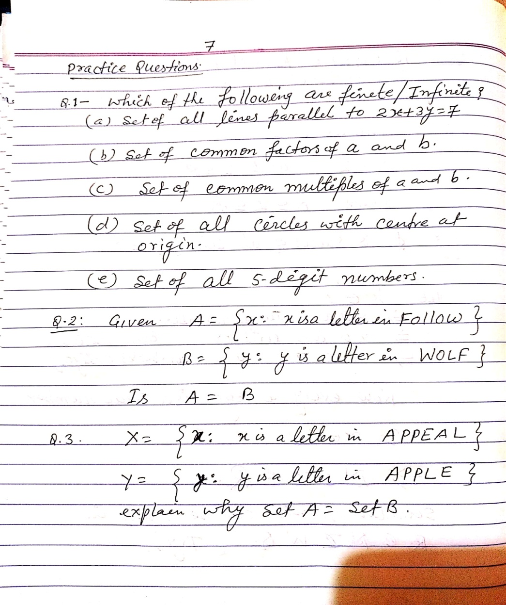
Practice Qs

Slide 9
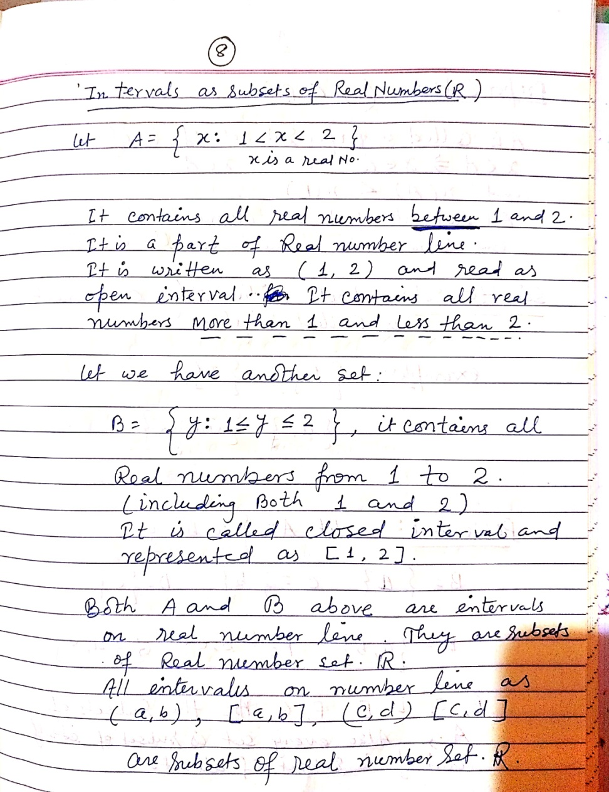
Intervals as Subsets of Real Number set

Slide 10
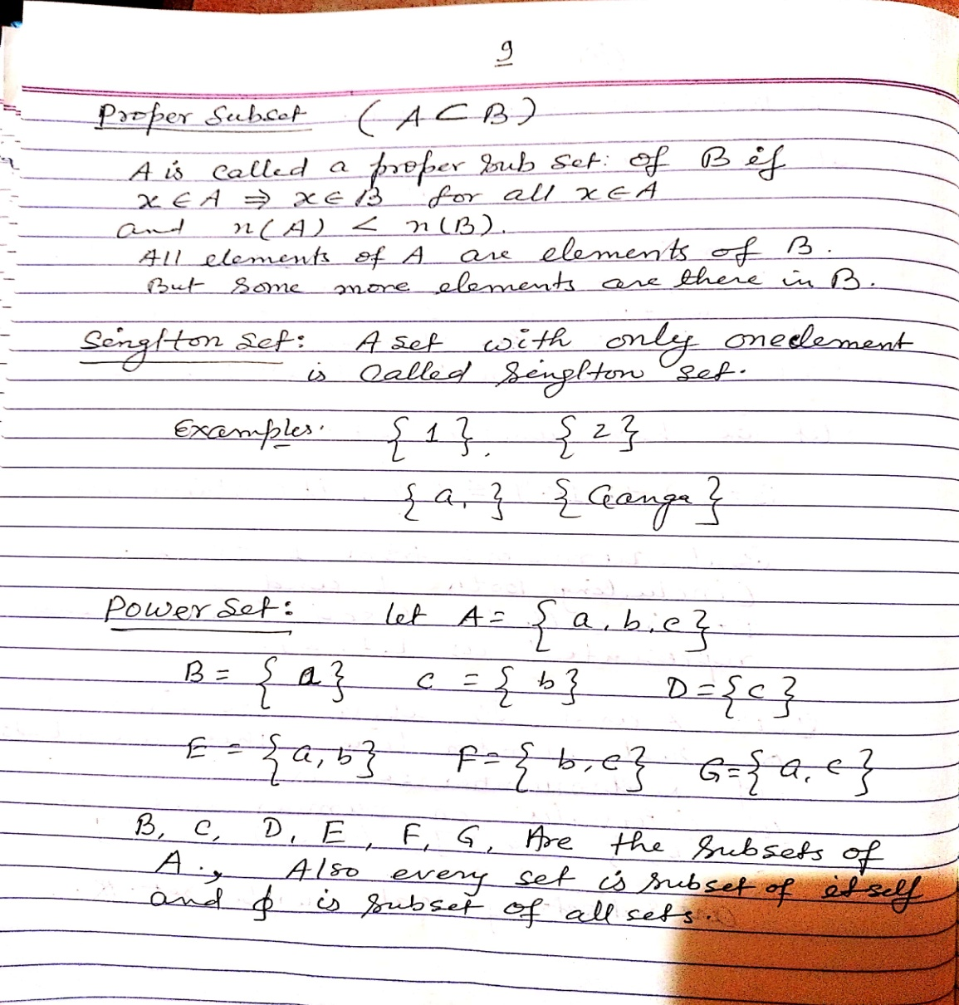
Proper Subset, Singleton and Power Set

Slide 11
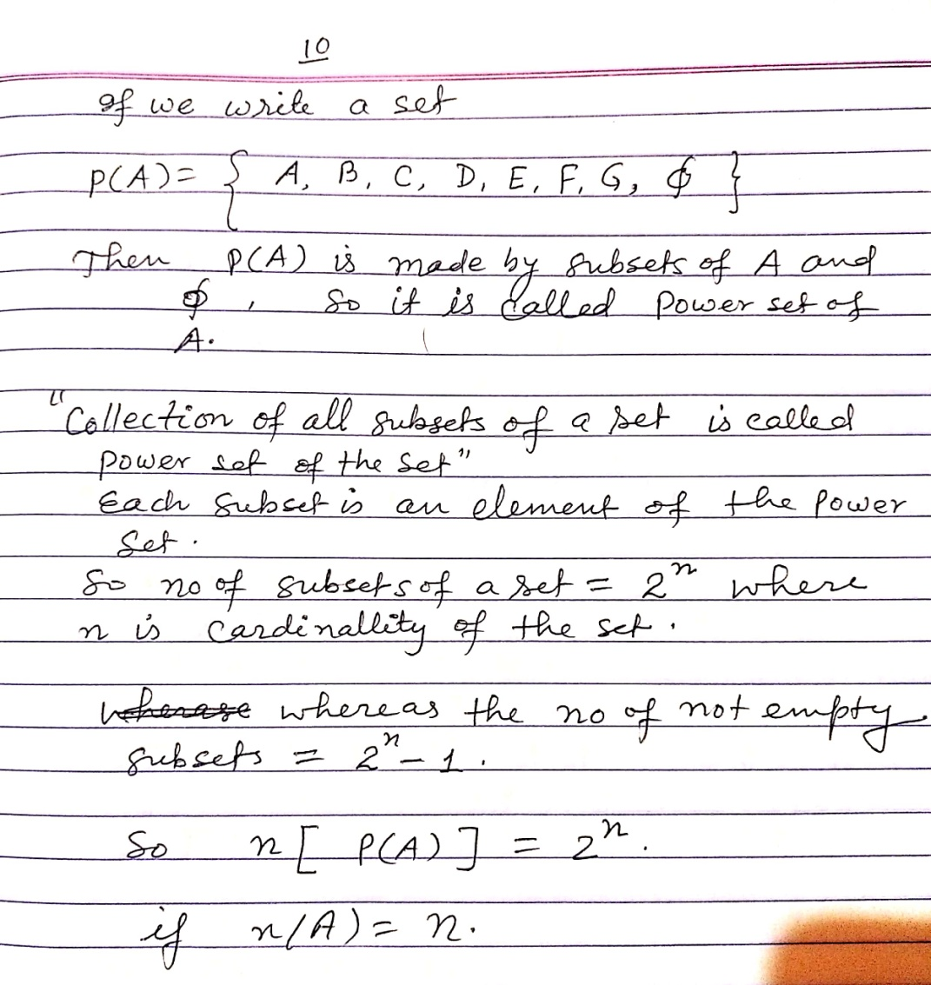
Power Set

